Slide 1
PROJECT- SUPERSTORE SALES DASHBOARD (PBI)
NAME- PRASAD.M.KULKARNI
COURSE- DATA SCIENCE AND AI
DATE- 10 TH NOVEMBER 2025

Slide 2
PROBLEM STATEMENT AND OBJECTIVE
Problem Statement - Due to the absence of clear product- and region-level analytics, the sales team was unable to monitor performance trends effectively, resulting in missed opportunities for targeted sales strategies and revenue optimization.
Objective/Goal - To create an interactive dashboard that displays key KPIs, trends, and forecasts to support strategic decision-making and help the organization fulfill long term vision

Slide 3
DATA OVERVIEW
DATA SOURCES - CSV AND EXCEL
KEY METRICS ADDRESSED IN PROJECT - SALES BY SEGMENT/REGION/ PAYMENT MODE, MONTHLY PROFIT, AVERAGE DELIVERY(DAX FUNCTION)
DATA CLEANING CHALLENGES FACED DURING PROJECT IMPLEMENTATION- NULL/DUPLICATE VALUES, INCONSISTENT DATA FORMAT,HANDLING OUTLIERS/MISSING DATA

Slide 4
STEPS PERFORMED: ETL IN POWER QUERY
DATA CLEANING-REMOVING NULLS/REPEATED VALUES/INCORRECT DATA
CALCULATED COLUMNS/DAX MEASURES- AVERAGE DELIVERY
DAX MEASURE SHOWN BELOW:

Slide 5
KEY DAX MEASURES
DAX Function calculated for Sales Forecast using Summarize function shown below.
Sales Forecast = SUMMARIZE ('Super Store _ Sales_ Dataset', 'Super Store_ Sales_ Dataset’ [Order Date],"Total Sales", SUM(Super Store_ Sales_ Dataset[Sales]))
DAX Function for Average Delivery calculated using Dated IFF function shown below.

Slide 6
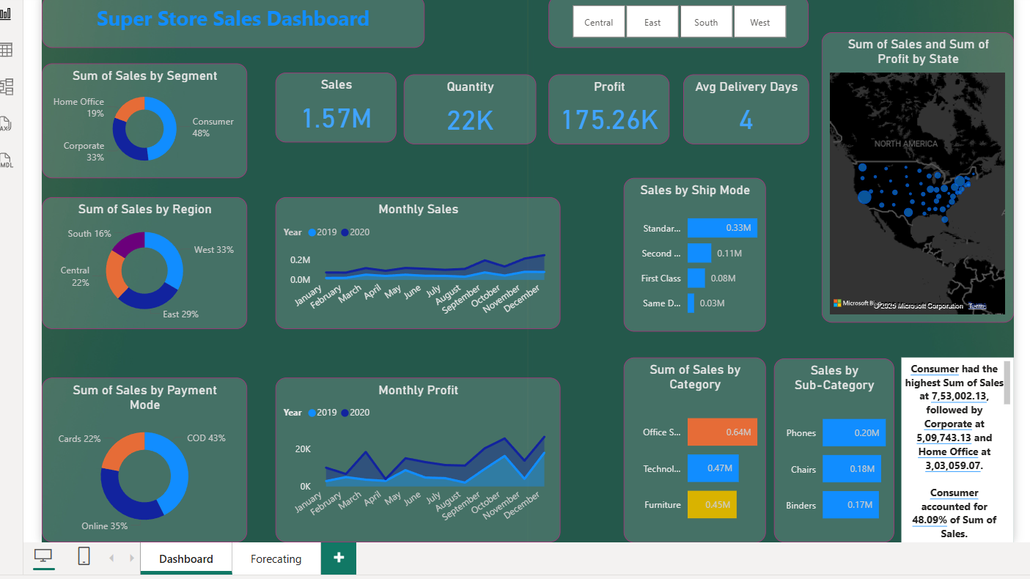
DASHBOARD DESIGN LAYOUT

Slide 7
DASHBOARD EXPLANATION AND METRICS USED
Use of Donut Chart to represent “Sum of Sales” by “Region/Segment/Payment Mode”. Systematic representation which will help stakeholders to capture key insights and will ultimately help the organization in the near future.
Monthly Profit and Monthly Sales shown via Area Chart for the respective years 2019 and 2020. Area Chart used to highlight magnitude of values.
Smart Narrative also used which highlights key insights

Slide 8
KEY INSIGHTS
In Sum of Sales by Region- Western Region dominates (33%) followed by East (29%) , Central Region (22%) and South (16%).
Standard Mode is generally the preferred ship mode.
Cash on Delivery is the preferred mode of Payment

Slide 9
THANK
YOU

